Slide 1
Multi-Robot Coordination in Underwater Mothership-Passenger Systems
Nathan L. Butler, candidate for MS in Robotics
Collaborative Robotics and Intelligent Systems (CoRIS) Institute, Oregon State University
Advisor: Dr. Geoff Hollinger
September 10, 2025
NSF Award No.
2322055

Slide 2
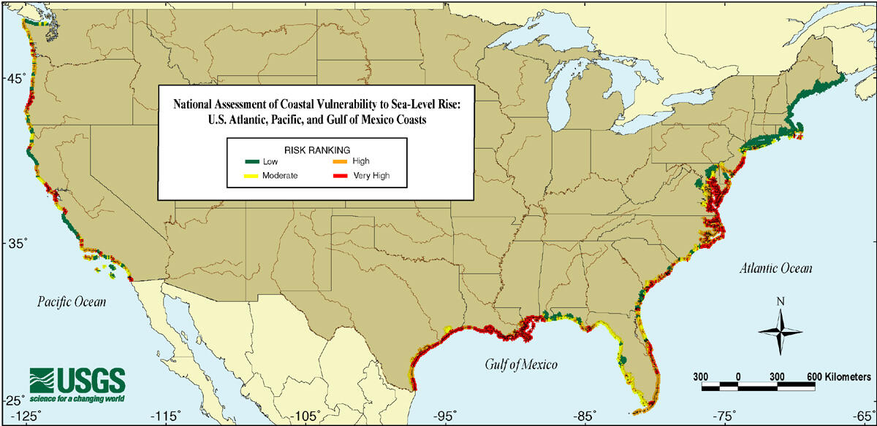
Rising Sea Levels Threaten Coastal Communities
US Geological Survey (2000), Public Domain
Intro.
Contrib. 1
Contrib. 2
Summary

Slide 3
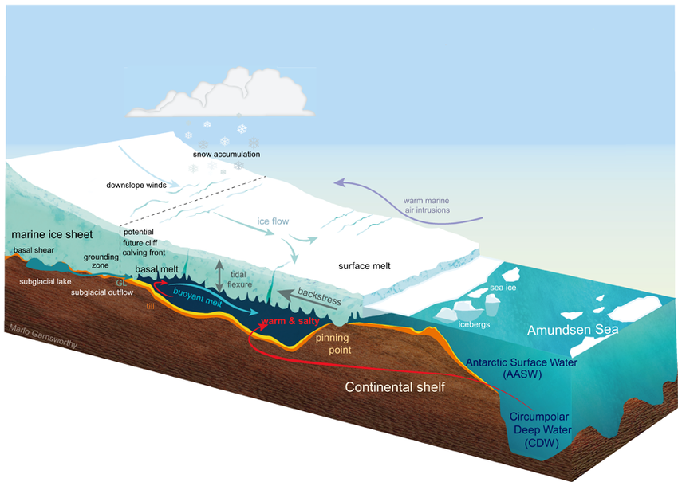
Ocean-Terminating Glaciers are Data-Rich, but Hazardous
Thwaites Glacier
Antarctica
Intro.
Contrib. 1
Contrib. 2
Summary
Larter (2022), Geophysical Research Letters
Notes:
Ocean-terminating glaciers are key contributors to sea level rise, as they are melted from both above and below. What are some key challenges that we’d identify for this environment? Narrow, constrained areas, turbulent ocean currents, no surface access.

Slide 4
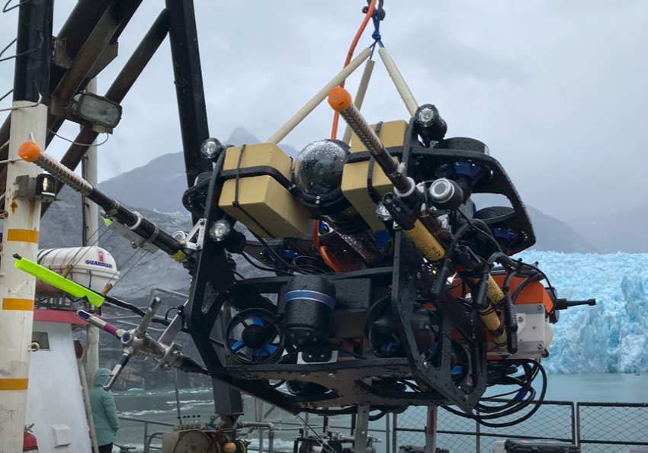
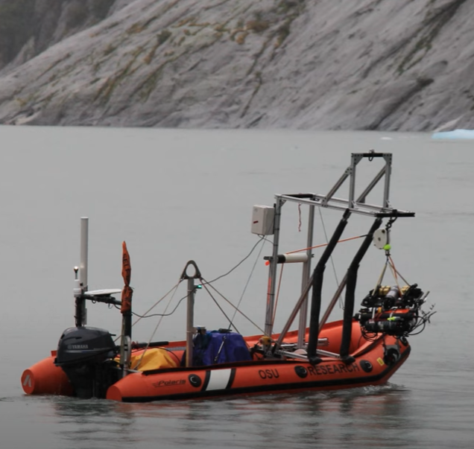
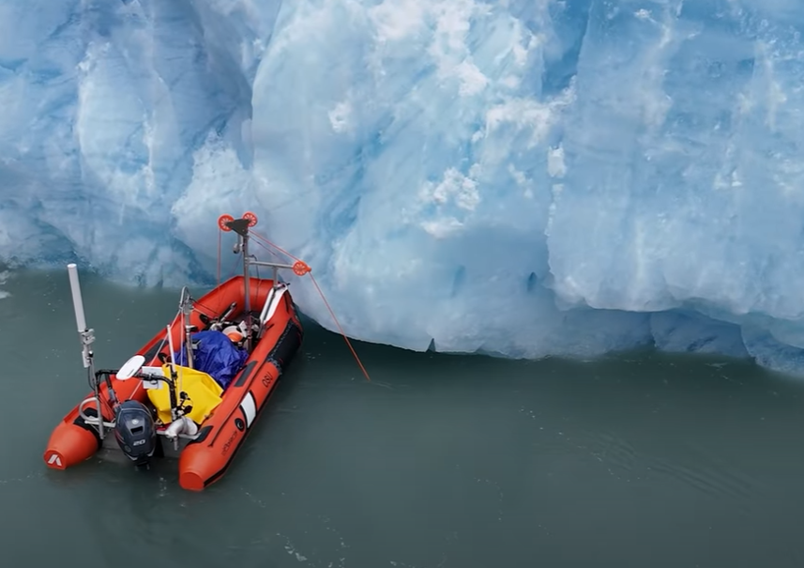
Exploring Glaciers with Robots @OSU
OSU, Measuring Glaciers with Robots, Youtube (2025)
Intro.
Contrib. 1
Contrib. 2
Summary
Notes:
These factors prompt the use of AUVs for exploring this environment. AUVs have been used for marine missions before, however the hazards of the under-ice domain prompt the use of a special type of system that mitigates the risk of expensive equipment loss.

Slide 5
Mothership-Passenger Systems
Deploying multi-robot team in marine under-ice environments
Mothership
Intro.
Contrib. 1
Contrib. 2
Summary
Notes:
Here we introduce the Mothership-Passenger system. We note that in this system, there are multiple avenues for coordinating the Passengers.

Slide 6
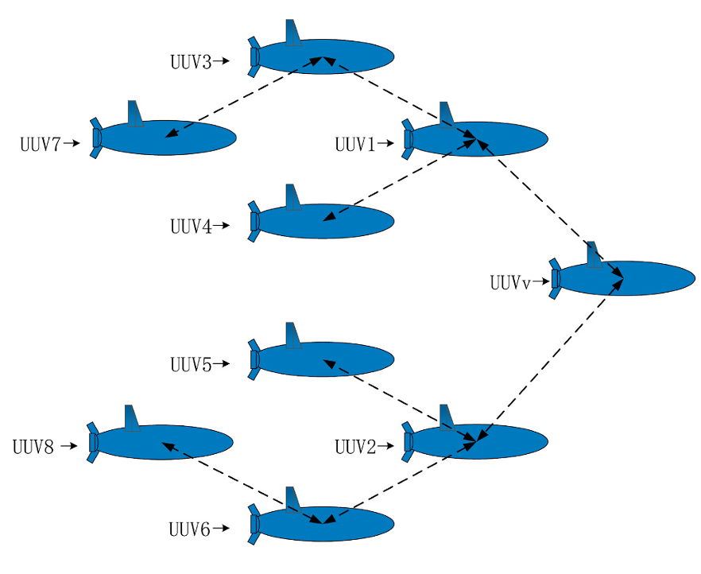
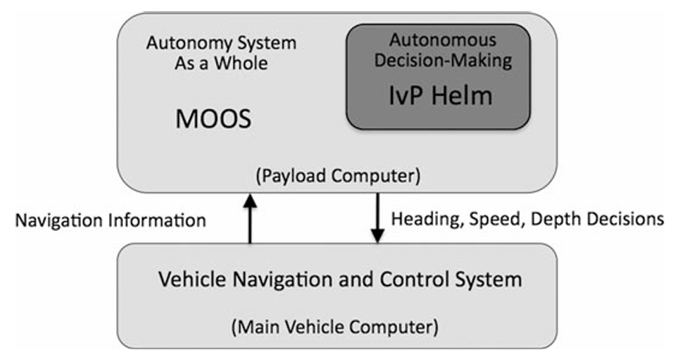
Multi-AUV Mission Planning Frameworks
Centralized coordination
Decentralized coordination
AUV 1
Bid
AUV 2
Bid
AUV 3
Bid
Yan et al. (2020), Ocean Engineering
Wang et al. (2022), Ocean Engineering
Hybrid coordination
Initial mission definition
Upload
AUV 1
AUV n
Decentralized refinement
Benjamin et al. (2010), JFR
MahmoudZadeh & Yazdani (2023), Ocean Engineering
Intro.
Contrib. 1
Contrib. 2
Summary
Notes:
Other marine Mothership-Passenger systems have attacked MR coordination in these ways. Typically, initial mission planning with the Mothership followed by decentralized execution with limited adaptation. While acceptable in relatively short-horizon, static environments, long term deployments in dynamic environments requires methods with enhanced Passenger robot agency/responsiveness. This brings us to our gap.

Slide 7
Thesis Statement
We can leverage a Mothership’s global perspective and computational advantages to bolster decentralized Passenger mission planning routines.
Intro.
Contrib. 1
Contrib. 2
Summary
Notes:
How can we leverage the high compute and global perspective offered by a Mothership to enhance team coordination in decentralized Passenger autonomy routines?

Slide 8
Mission Planning Challenges
Task allocation and routing
Energy and/or time budgets
Uncertain environment features
Mission disruptions and dynamics
Comms bandwidth limits
Complex task requirements
Hybrid Decentralization for Multi-Robot Orienteering with Mothership-Passenger Systems
Learning-Based Coordination for Mothership-Passenger Systems in Complex Task Domains
Intro.
Contrib. 1
Contrib. 2
Summary

Slide 9
Outline
Introduction: Mothership-Passenger systems and underwater multi-robot mission planning
Contribution 1: Hybrid-decentralization for multi-robot orienteering with Mothership-Passenger systems
Contribution 2: Learning-Based Coordination for Mothership-Passenger Systems in Complex Task Domains
Summary: Conclusions, contributions, and future work
Intro.
Contrib. 1
Contrib. 2
Summary

Slide 10
Hybrid Decentralization for Multi-Robot Orienteering with Mothership-Passenger Systems
Intro.
Contrib. 1
Contrib. 2
Summary

Slide 11
T
Multiple robots deploy,
complete tasks, and return
T
Mothership
T
T
T
T
T
Intro.
Contrib. 1
Contrib. 2
Summary
Notes:
TRANSITION: We want to plan each robot’s path through these tasks. To do this, let’s get into some graph theory. Imagine each task as a node in a graph… (next slide).

Slide 12
The Stochastic Multiagent Orienteering Problem
T
T
?
?
T
T
T
T
T
T
?
?
?
?
T
Unvisited
(exceeds budget)
?
T
T
Mothership
Intro.
Contrib. 1
Contrib. 2
Summary
Notes:
MOP/SMOP slide – continuing graph theory. Each task is a node separated by some real-world cost/distance. Here is what we want to do…

Slide 13
How can a hybrid centralized-decentralized network topology available in Mothership-Passenger systems be used to solve complex orienteering problems?
Intro.
Contrib. 1
Contrib. 2
Summary
Notes:
Gap

Slide 14
Hybrid Mission Planning
Observed local data
Received global data
Passenger k
Use local observations
Mothership
Use global observations
Locally-informed plans
Globally-informed plans
Decentralized Planning
Centralized Planning
Intro.
Contrib. 1
Contrib. 2
Summary

Slide 15
Decentralized Planning on Passengers
Passenger k
Decentralized Planner
(Best et al. 2020)
Neighboring Robots
Plan Valuation & Selection
Local Candidate Plans
Intro.
Contrib. 1
Contrib. 2
Summary
Notes:
TODO (opt.) discuss planning distribution

Slide 16


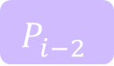


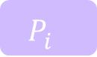
Centralized Planning on Mothership
We solve Stochastic Team Orienteering Problem (STOP) on Mothership
Mothership
Mothership
Centralized Solver
(Sim-BRVNS [X])
Centralized Planner
(Panadero et al. 2023)
$$P_{i−2}^{}$$
$$P_{i}^{}$$
$$P_{i−1}^{}$$
$$P_{j}^{}$$
$$P_{i}^{}$$
$$P_{k}^{}$$
Joint solutions
Intro.
Contrib. 1
Contrib. 2
Summary

Slide 17
Hybrid Framework
Mothership
Passenger k
Centralized Planner
(Panadero et al. 2023)
Stored Plans
Decentralized Planner
Neighboring Robots
Plan Valuation & Selection
$$P_{i}^{}$$
$$P_{j}^{}$$
$$P_{k}^{}$$
Candidate Plans
Intro.
Contrib. 1
Contrib. 2
Summary

Slide 18
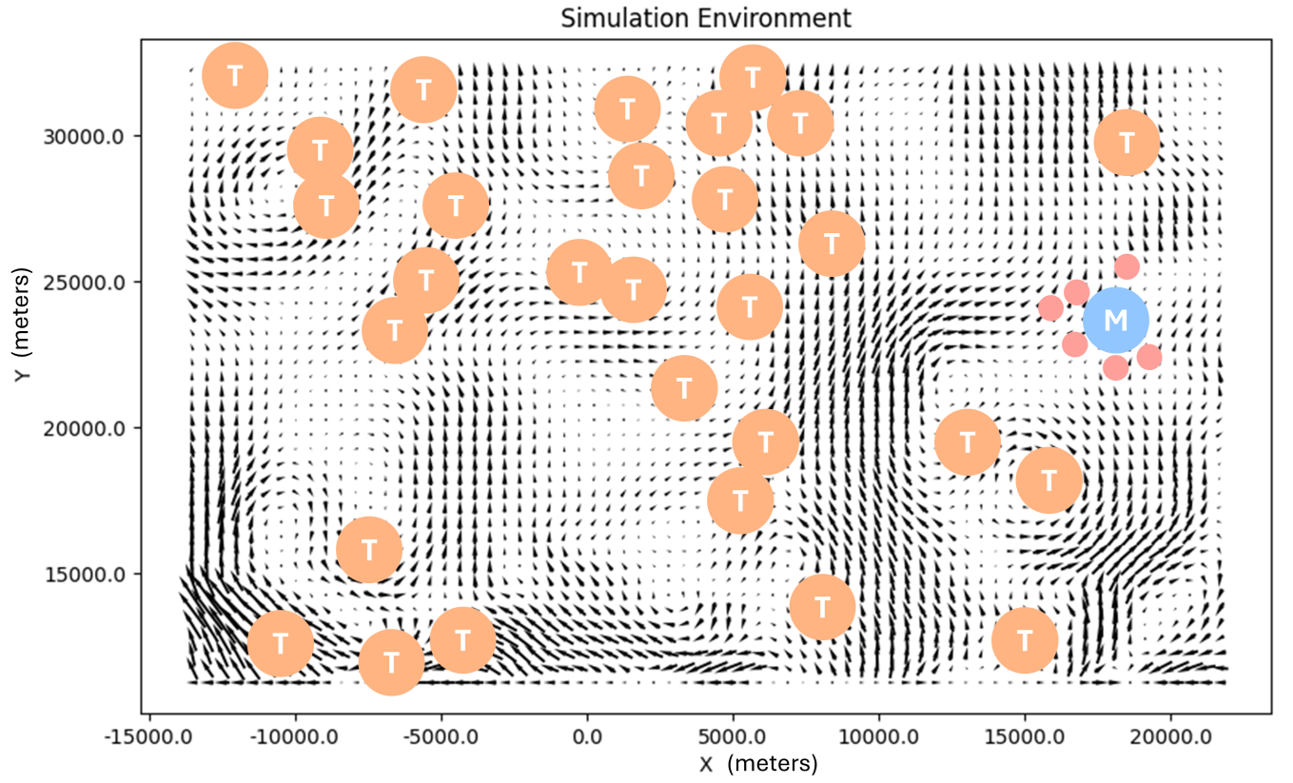
Evaluation in Simulated Ocean Domain
Tasks (T)
Mothership Location (M)
Deployed Passengers
Flow field data from Si et al. (2024)
Intro.
Contrib. 1
Contrib. 2
Summary

Slide 19
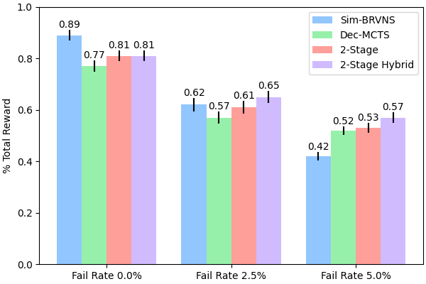
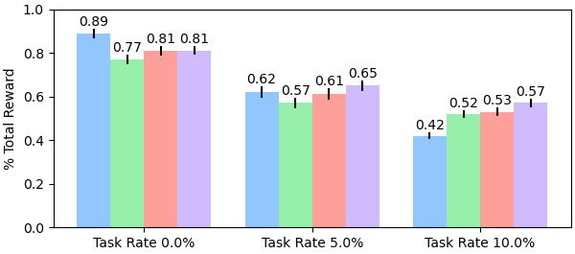
Experimental Results
Algorithms evaluated:
Initial, centralized solution only
Decentralized planning only
6 Robots, 20 Tasks
Initial + decentralized replanning
Initial + hybrid replanning
Task Completion Rate (Higher is better)
Initial (centralized) solution -> immediate coordination boost
Mothership-assisted replanning -> greater resilience to disturbances
Increasing problem difficulty
Intro.
Contrib. 1
Contrib. 2
Summary

Slide 20
Contribution 1 Conclusions
Introduced Stochastic Multiagent Orienteering Problem
Explored leveraging mothership for hybrid decentralized problem solving
Evaluated scenarios where integrated mothership provides greatest benefits
Intro.
Contrib. 1
Contrib. 2
Summary

Slide 21
Contribution 1 Publications
N. Butler and G. Hollinger, “ Hybrid Decentralization for Multi-Robot Orienteering with Mothership-Passenger Systems ,” in Proc. of the 42nd IEEE International Conference on Robotics and Automation, Atlanta, GA, May 2025.
N. Butler, G. Hollinger, J. Garwood, Y. Si, and A. Stewart, “Pseudo-Centralized Mission Planning for Under-Ice Robotic MOTHERSHIPs” [Poster]. 2nd Northwest Robotics Symposium, Corvallis, OR, April 2024.
Intro.
Contrib. 1
Contrib. 2
Summary

Slide 22
Learning-Based Coordination for Mothership-Passenger Systems in Complex Task Domains
Intro.
Contrib. 1
Contrib. 2
Summary

Slide 23
Mission Planning Challenges
Task allocation and routing
Energy and/or time budgets
Uncertain environment features
Mission disruptions and dynamics
Comms bandwidth limits
Complex task requirements
Hybrid Decentralization for Multi-Robot Orienteering with Mothership-Passenger Systems
Learning-Based Coordination for Mothership-Passenger Systems in Complex Task Domains
Intro.
Contrib. 1
Contrib. 2
Summary

Slide 24
Multi-Robot Coordination for Complex Tasks
Completing tasks may require robots to take adaptive, coordinated actions.
Communication relay behaviors
Exploration & discovery
Mothership
Mothership
T
T
Intro.
Contrib. 1
Contrib. 2
Summary
Notes:
Real world sees complex tasks that may require multi-robot coordination.
Could discuss IvP Helm here

Slide 25
How can we coordinate and adapt multi-robot behaviors to complete complex tasks in dynamic, comms-constrained environments using a Mothership-Passenger system?
Intro.
Contrib. 1
Contrib. 2
Summary
Notes:
How can we coordinate, and adapt multi-robot roles for dynamic, low-comms environments using a Mothership-Passenger system?

Slide 26
Mothership-Coordinated Adaptive Passenger Specializations (MCAPS)
Goals:
Maintain Passengers’ autonomy for quick, flexible response to environmental dynamics
Allow Mothership to influence each Passenger’s individual planning objectives to improve overall team performance
Intro.
Contrib. 1
Contrib. 2
Summary
Notes:
Let’s try taking advantage of some domain knowledge without intensive, rigid behavior engineering (Maybe not include: or complex reward functions)?

Slide 27
Passenger Candidate Objective Functions
Provide each Passenger with a set of domain-inspired Candidate Objective Functions
T
Complete nearby tasks
Maintain comms links
Mothership
Explore frontiers
Return to Mothership
Apply domain knowledge without extensively engineered objective functions.
Intro.
Contrib. 1
Contrib. 2
Summary
Notes:
Let’s try taking advantage of some domain knowledge without intensive, rigid behavior engineering (Maybe not include: or complex reward functions)?
Now, how do we decide when to prioritize which objectives for each robot? Let’s give this decision to the Mothership & take advantage of its global perspective.

Slide 28
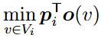
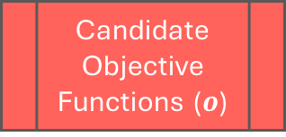
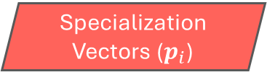
Mothership-Coordinated Adaptive Passenger Specializations (MCAPS) Framework
Mothership Data & Operations
[0.15, -0.36, 0.02, …]
Observation Packets
Coordination Policy
Passenger i Data & Operations
Specialization Vectors ($p_{i}$)
state, reward
Environment Rollouts
Decentralized Planners
Candidate Objective Functions ($o$)
Goal:
Intro.
Contrib. 1
Contrib. 2
Summary
Notes:
Candidate objectives inform local planners. Robots operate in environment & aggregate data at Mothership. How can individual objectives be prioritized? With Spec Vectors. How do we know what these vectors should be? Train a policy on the Mothership.

Slide 29
Mothership Coordination Policy
Transformer-Based Model
Inspired by Multi-Agent Transformer (MAT), Wen et al. (2022)
Observation Packets
Coordination Policy
Observation attention
Passenger & observation attention
Environment
Encoder Block
Decoder Block
Passenger i Spec. Vector
Sources:
Passenger 1
Passenger 2
Passenger 3
?
Robot Token Extraction
Passenger i token
Intro.
Contrib. 1
Contrib. 2
Summary

Slide 30
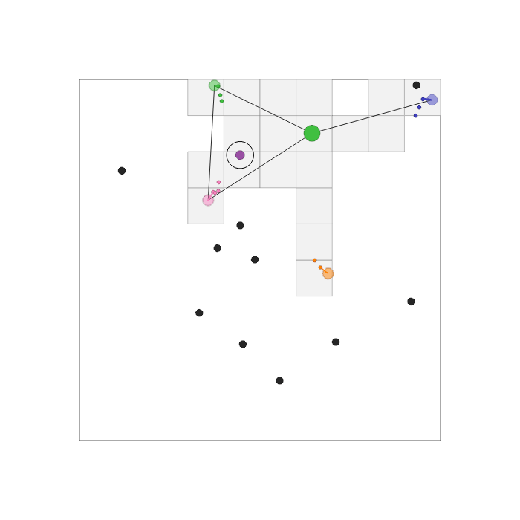
Simulation Environment
Custom Vectorized Multi-Agent Simulator (VMAS) Environment
(Bettini et al. 2022)
Static Mothership position (green dot)
Four agents, capable of: discovering regions, completing tasks, and relaying comms
Plan waypoints visualized
Comms connections visualized
Random obstacles (black dots)
Explored regions (grey tiles) are candidates for task spawns (colorful dots)
Intro.
Contrib. 1
Contrib. 2
Summary

Slide 31
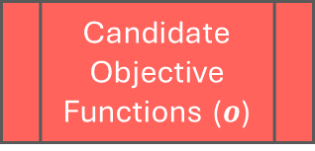
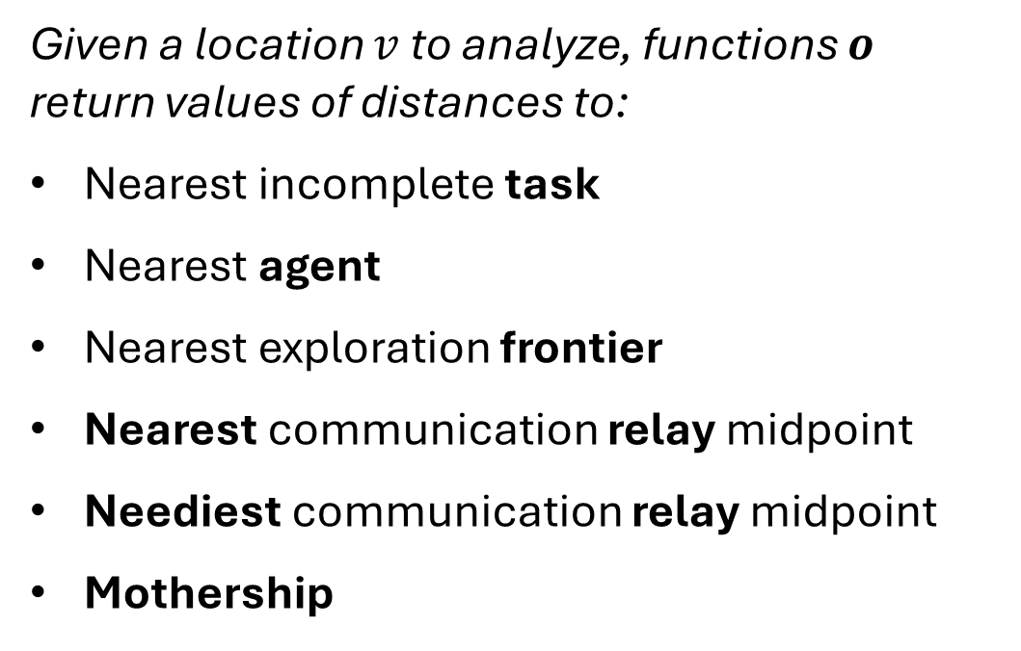
Passenger Candidate Objective Functions
Given a location $v$ to analyze, functions $o$ return values of distances to:
Nearest incomplete task
Nearest agent
Nearest exploration frontier
Nearest communication relay midpoint
Neediest communication relay midpoint
Mothership
Decentralized Planners
Candidate Objective Functions ($o$)
Goal:
Intro.
Contrib. 1
Contrib. 2
Summary

Slide 32
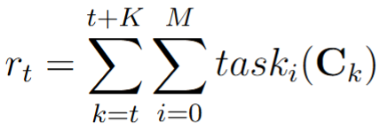
Training the Coordination Policy
Markov Decision Process Formulation
States: Observation packets aggregated at Mothership over rollout
Proximal Policy Optimization
(Schulman et al. 2017)
Actor-Critic RL method
Stable gradient updates
{obs_x, obs_y, num agents, num tasks, num obstacles, num frontiers, Mothership}
Actions: Specialization vectors for team
Rewards: Value accumulated from M tasks over a K-step action rollout, given team config C at each step
Actions occur over K-step scale
o
Value of task i, computed from team configuration – reduces with comms dist.
Intro.
Contrib. 1
Contrib. 2
Summary
Notes:
WE WANT TO DEAL WITH ACTIONS THAT OCCUR OVER A LONGER SCALE.
Episode: 8-16 K-step rollouts
Or, “Actions occur over an extended time horizon. Thus, our reward function for evaluating the impact of these actions considers a K-step rollout.”

Slide 33

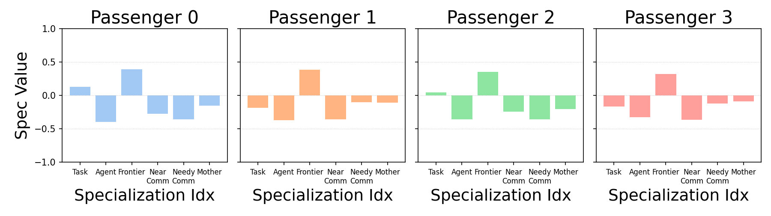
Training Evaluation – Specialization Adaptation
Step 1
Intro.
Contrib. 1
Contrib. 2
Summary

Slide 34
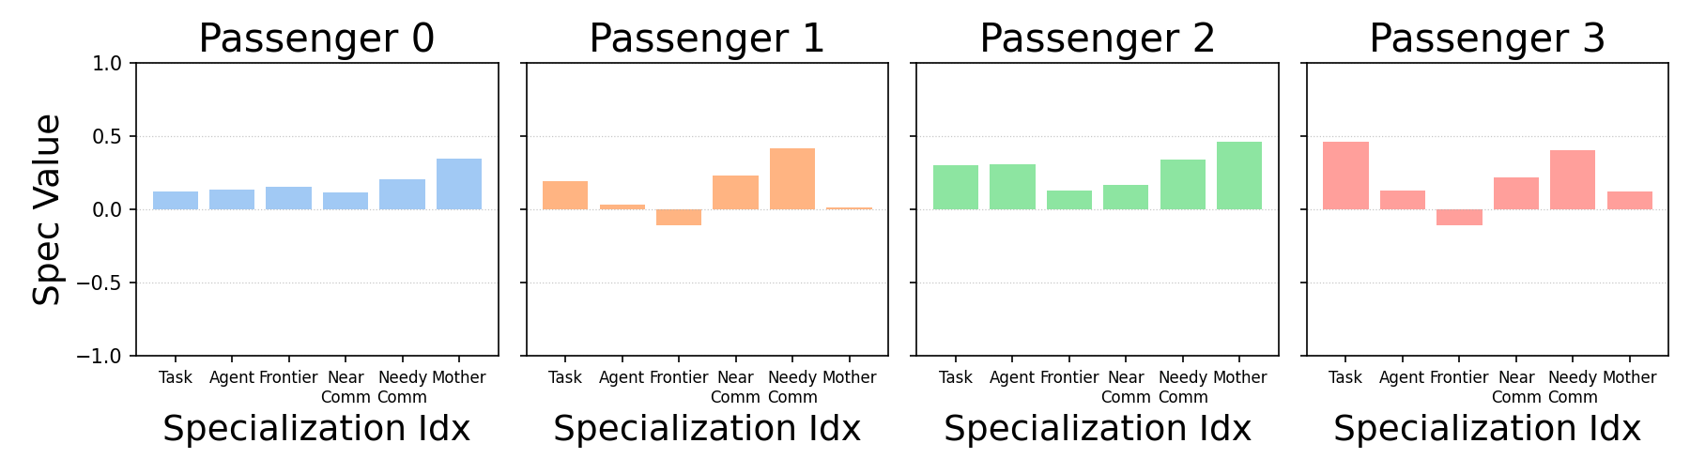
Training Evaluation – Specialization Adaptation
Step 1
Step 2
Intro.
Contrib. 1
Contrib. 2
Summary

Slide 35
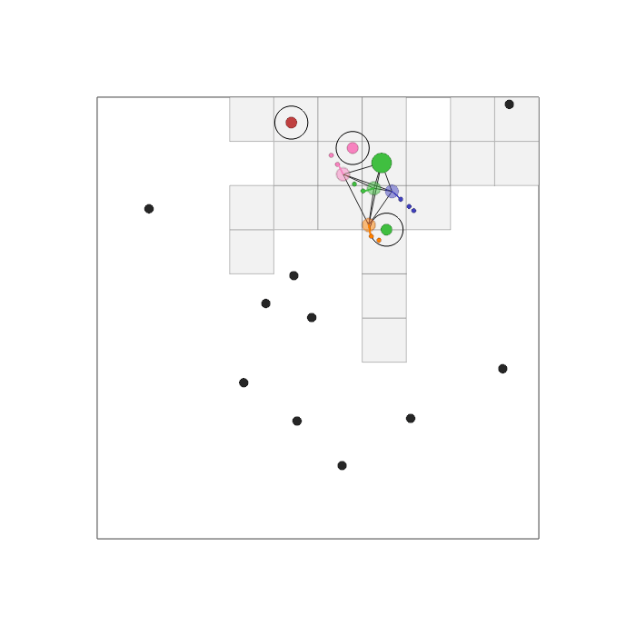
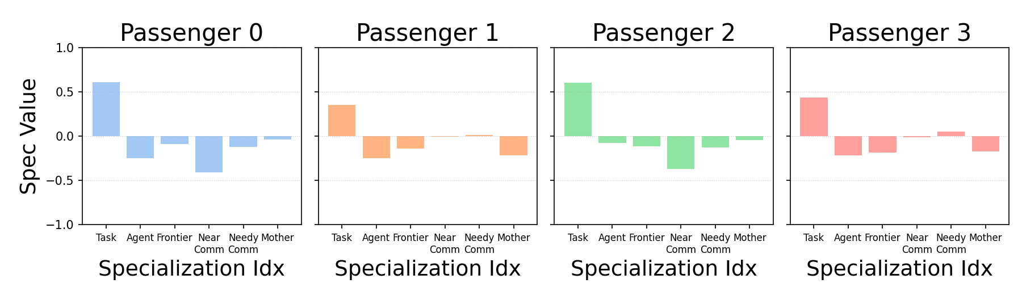
Training Evaluation – Specialization Adaptation
Step 1
Step 2
Step 3
Intro.
Contrib. 1
Contrib. 2
Summary

Slide 36
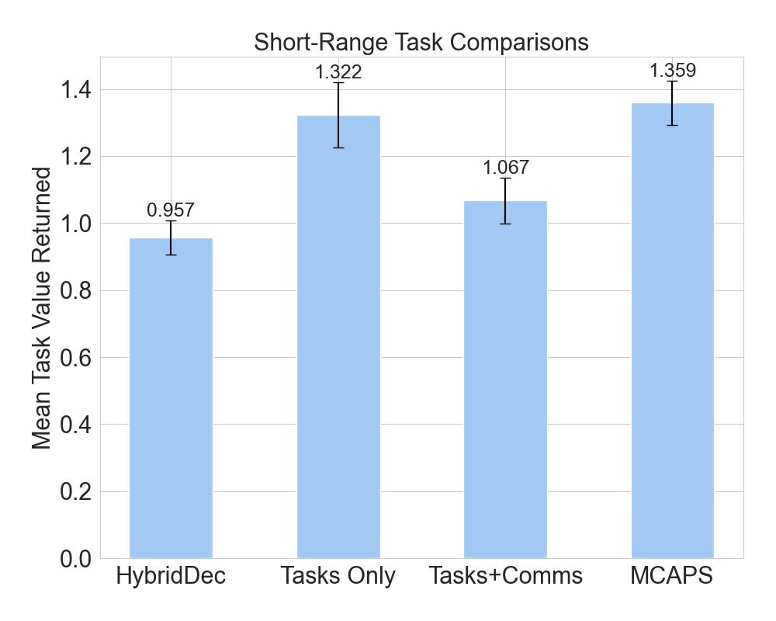
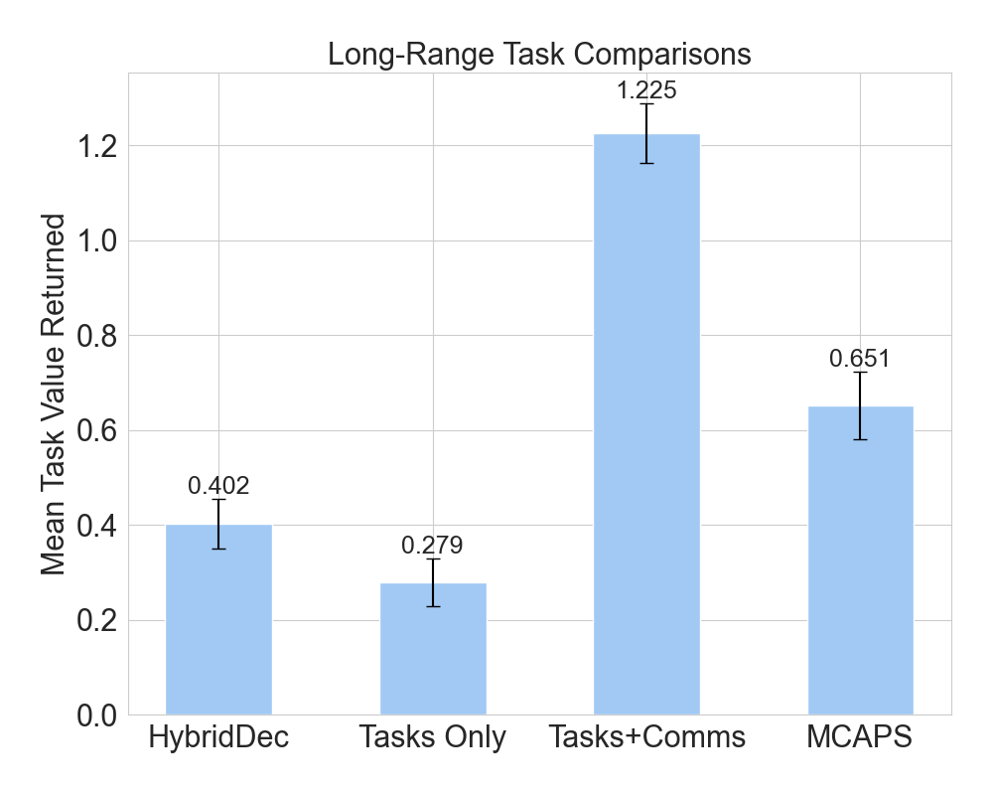
Evaluations Against Hybrid-Decentralized & Heuristics
Evaluate adaptation for comms-related team coordination
Comparisons:
HybridDec: Hybrid-Decentralized SMOP solver
Tasks Only: Passengers use only tasks objective
Tasks+Comms: Passengers split - half of team supports comms, half completes tasks
MCAPS (Ours)
Mean Task Value Returned
(Higher is better)
Mean Task Value Returned
(Higher is better)
Mean and SEM of task value communicated to Mothership over multiple randomized episodes
Intro.
Contrib. 1
Contrib. 2
Summary

Slide 37
Evaluations Discussion
MCAPS robust to variety of environment configurations
Coordination policy learned to balance environment exploration with task completion
Achieved high-performing results in short-range task setting, likely due to additional actions afforded over greedy heuristic
Achieved robust results in long-range task setting, but policy may have learned to emphasize close-range tasks
Additional notes:
Certain specializations not always used “as intended” – coordination policy learned alternative uses
Actions defined over K steps addresses infrequent updates from Mothership
Intro.
Contrib. 1
Contrib. 2
Summary

Slide 38
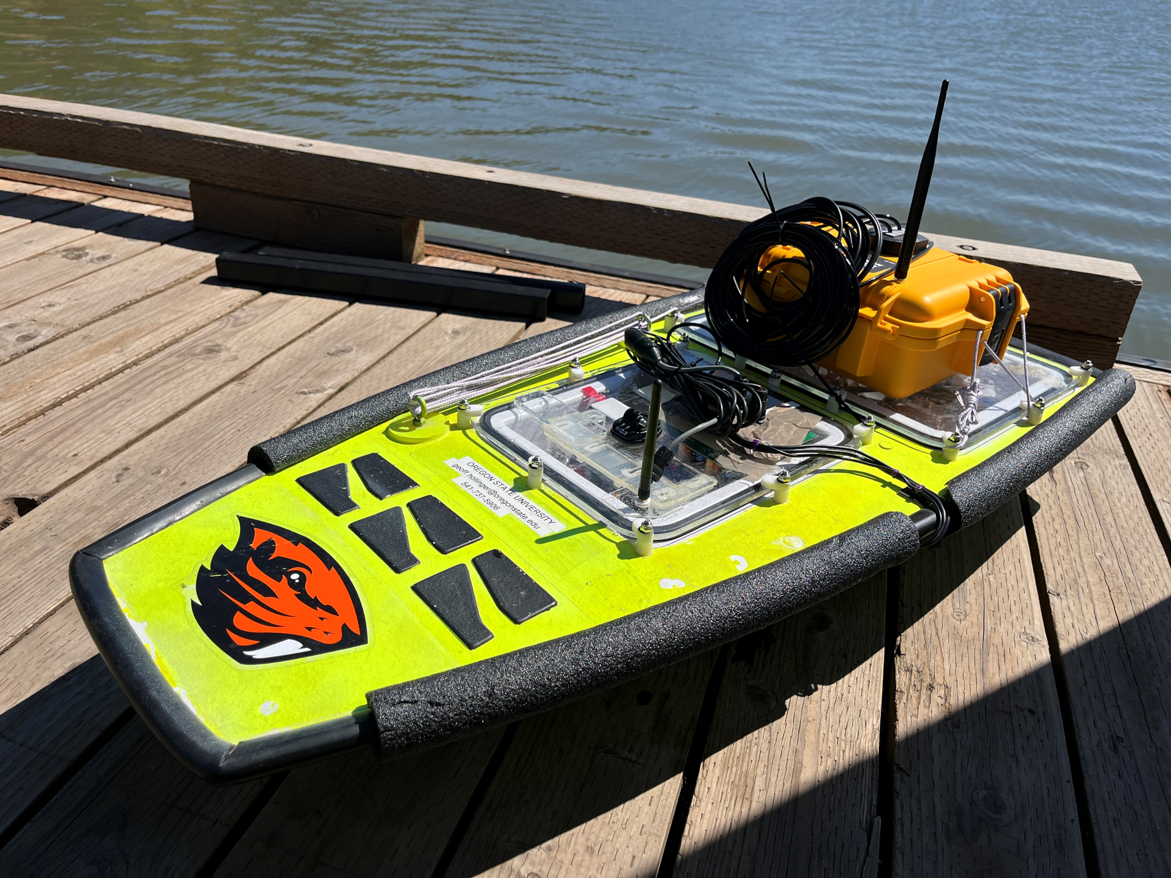
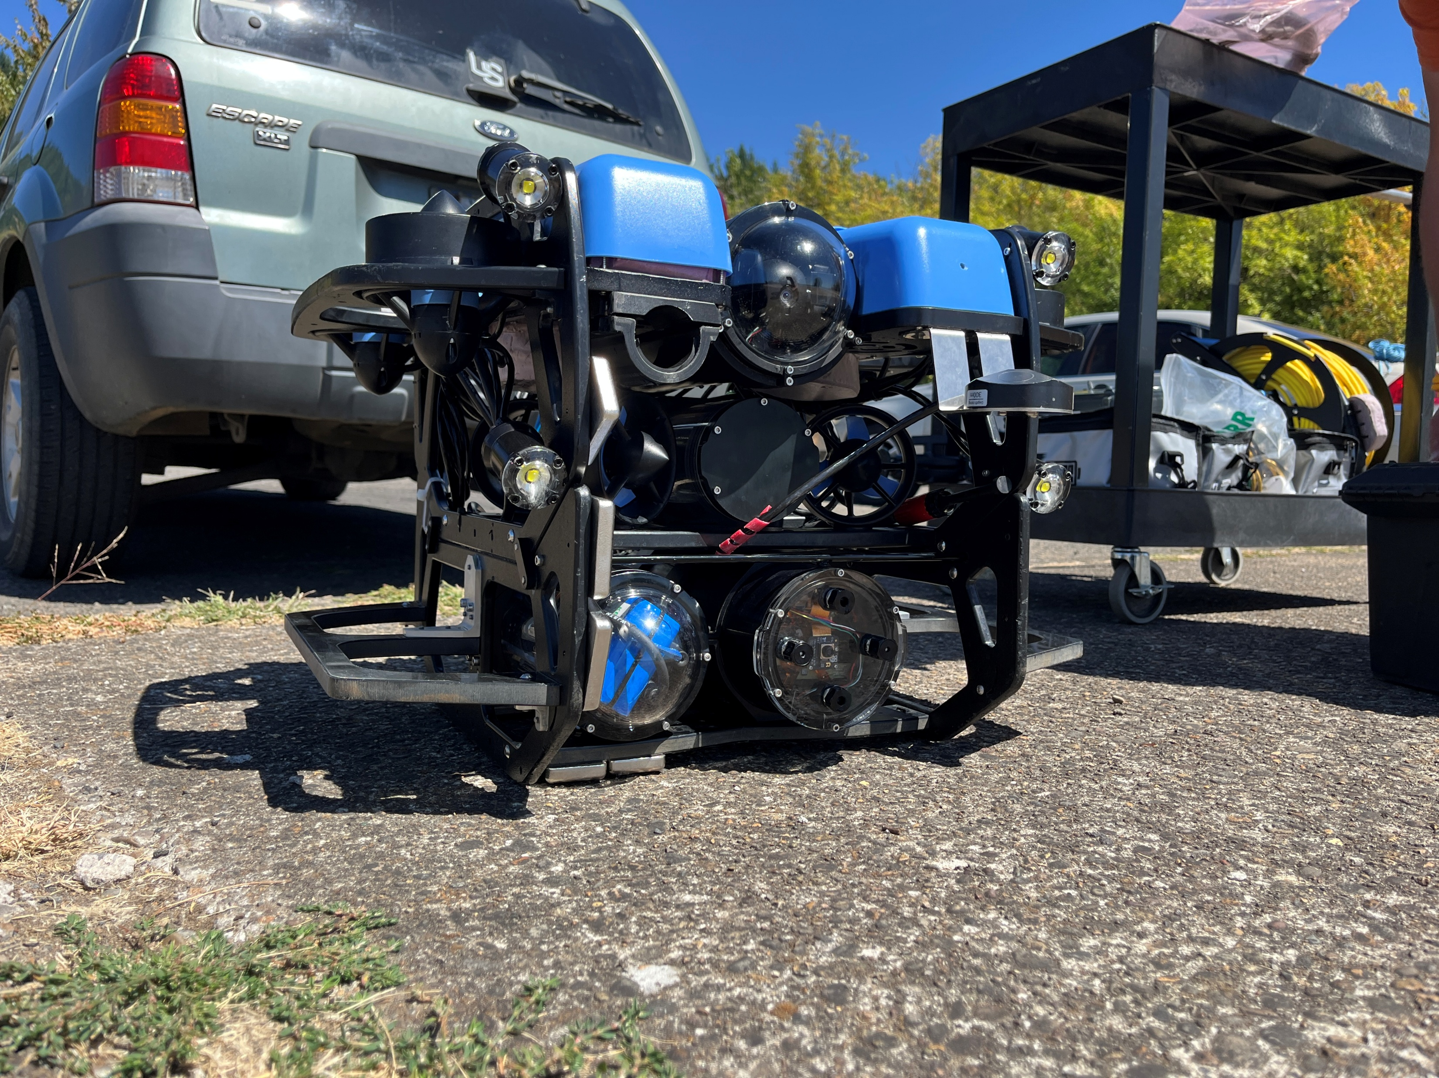
Hardware Trials
Fern Ridge Lake
Veneta, OR
Platypus Lutra Unmanned Surface Vehicle (USV)
Blue Robotics BlueROV Remotely Operated Vehicle (ROV)
Intro.
Contrib. 1
Contrib. 2
Summary

Slide 39
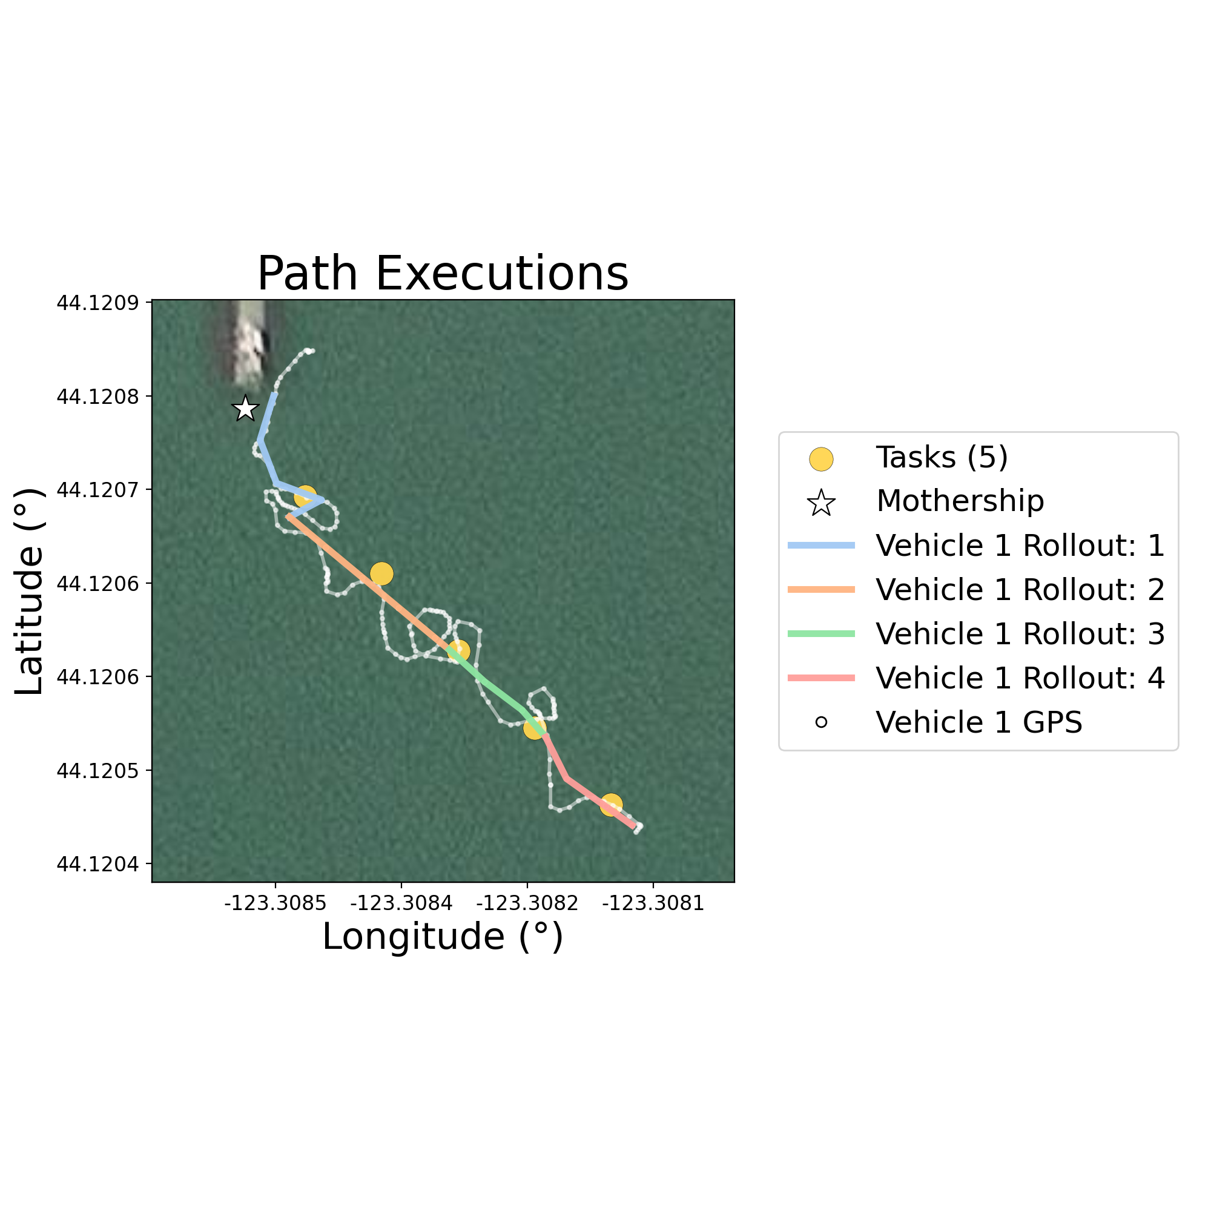
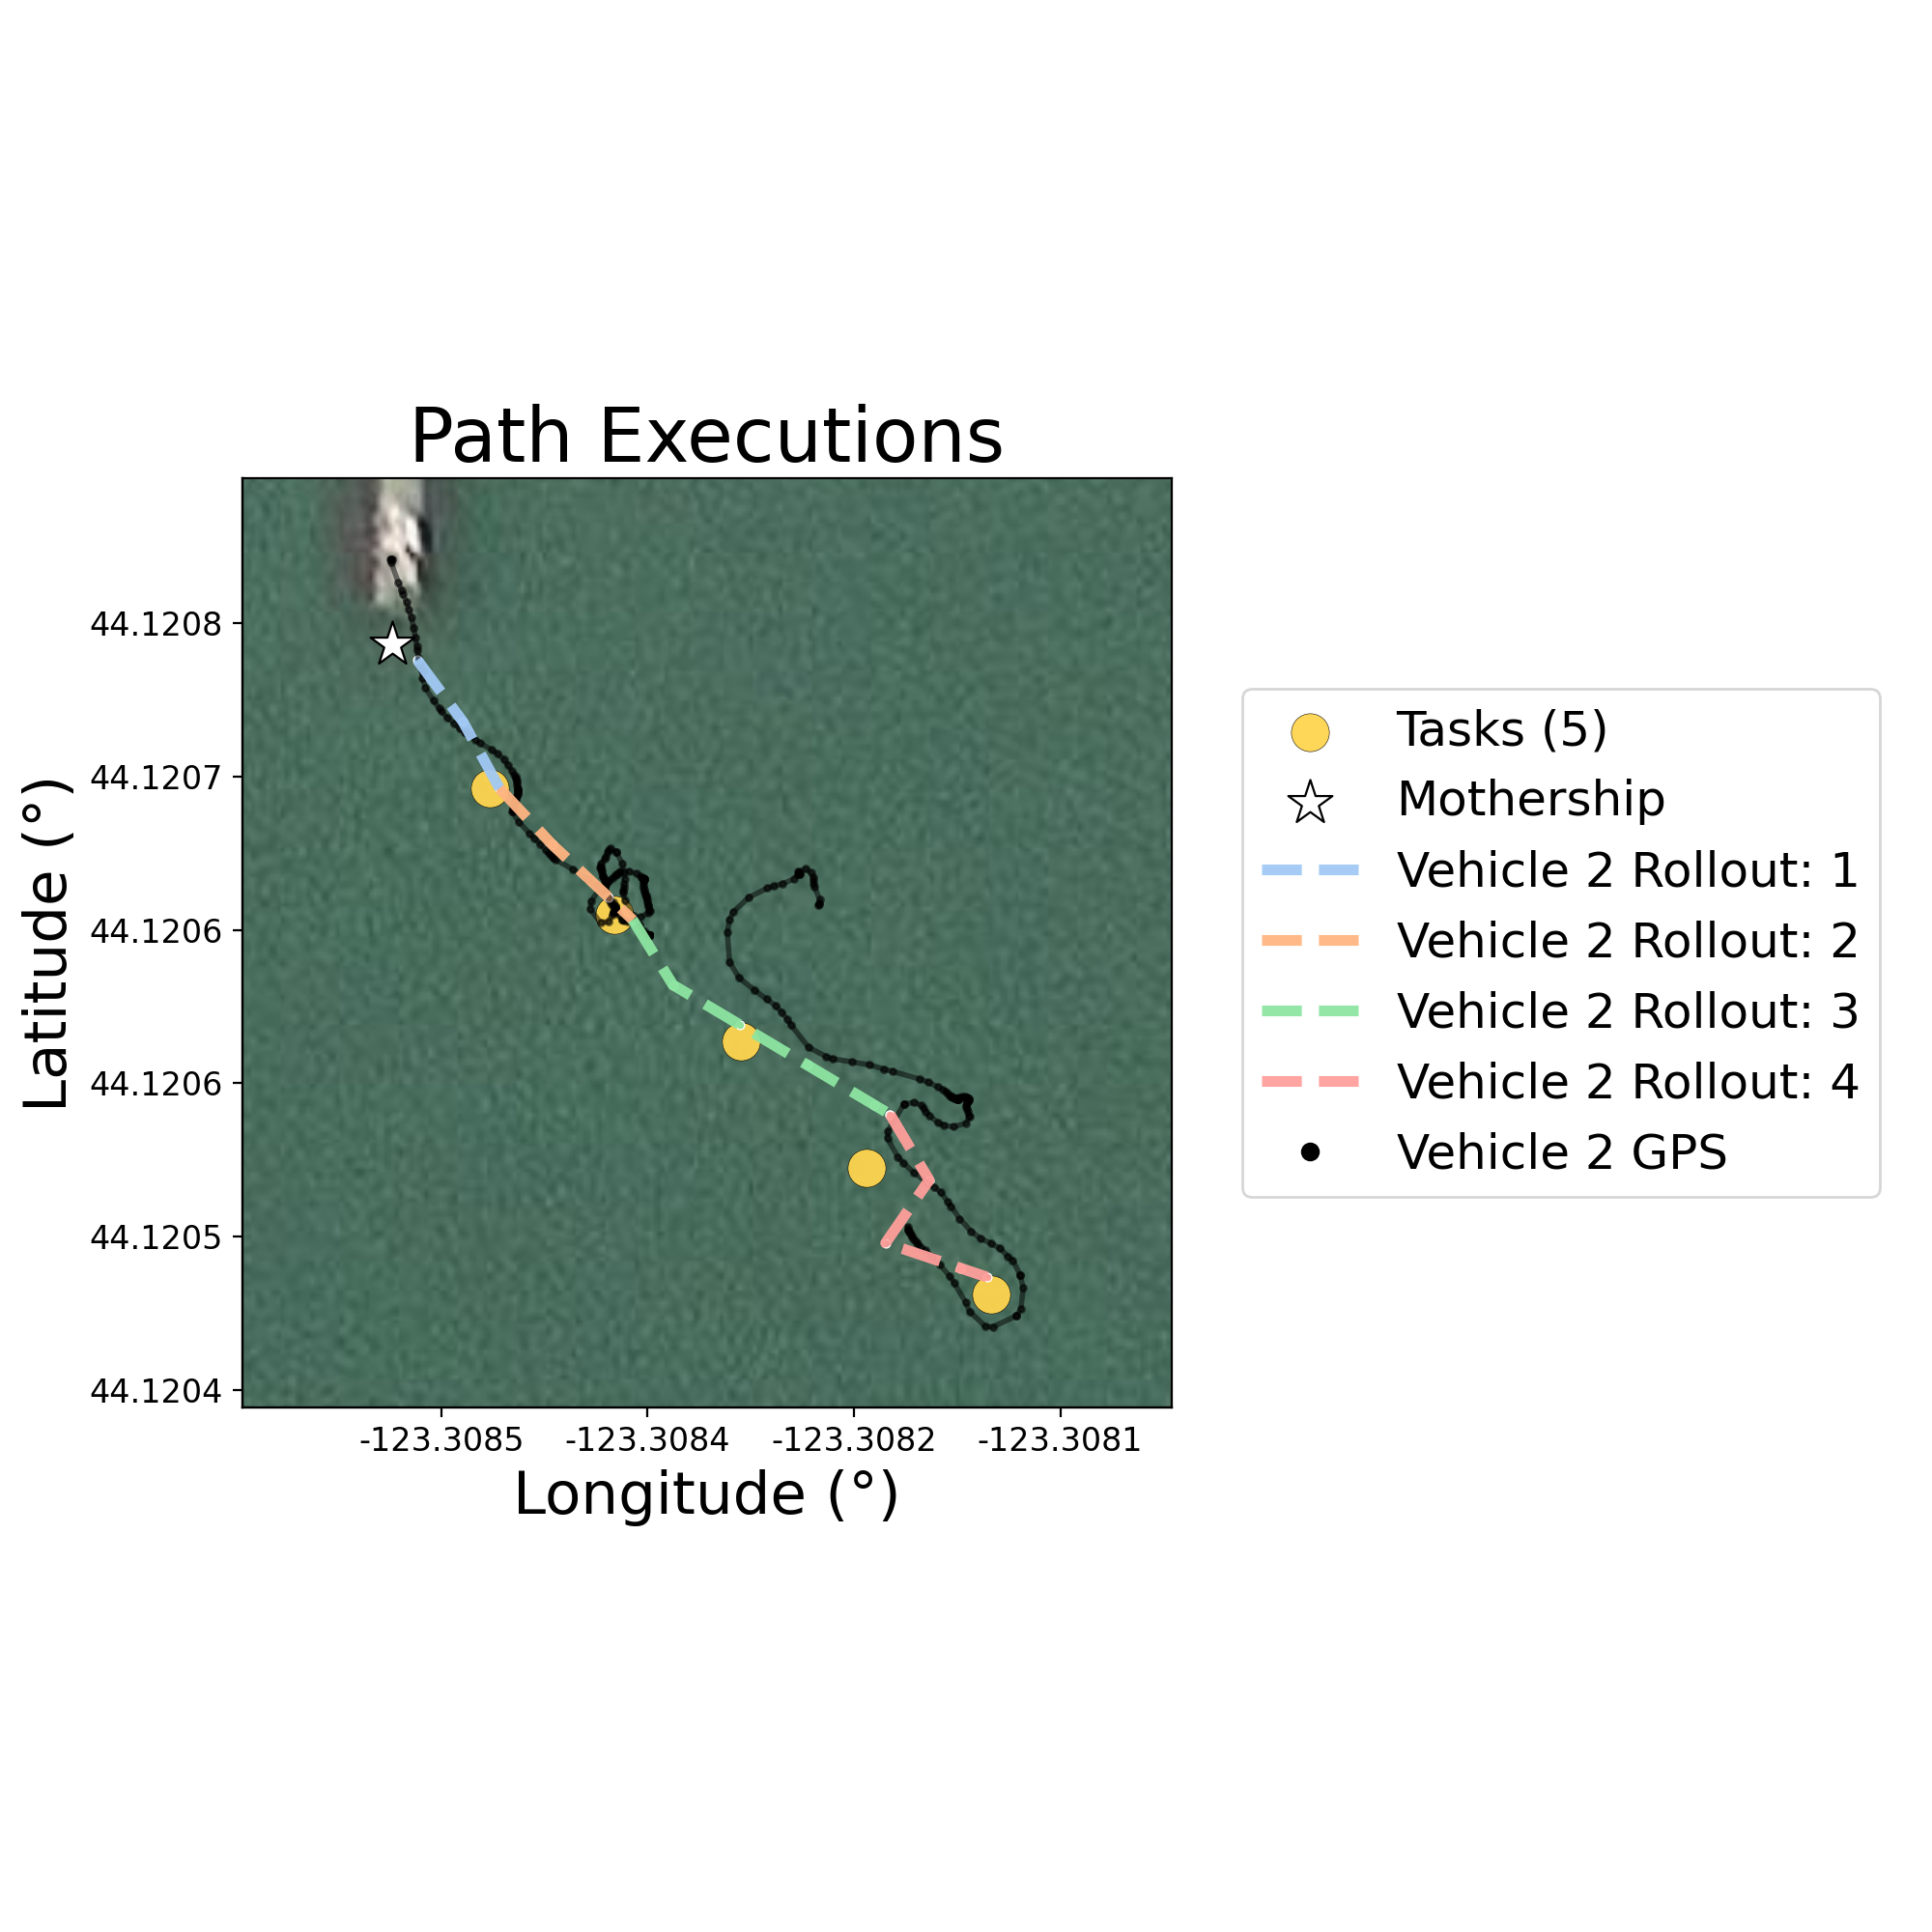
Greedy vs MCAPS Hardware Deployments
Greedy ROV Rollouts
Greedy USV Rollouts
Mothership
Start
Start
Tasks (5)
Step 1 Rollouts
Step 2 Rollouts
Step 3 Rollouts
Step 4 Rollouts
ROV GPS
USV GPS
Intro.
Contrib. 1
Contrib. 2
Summary

Slide 40
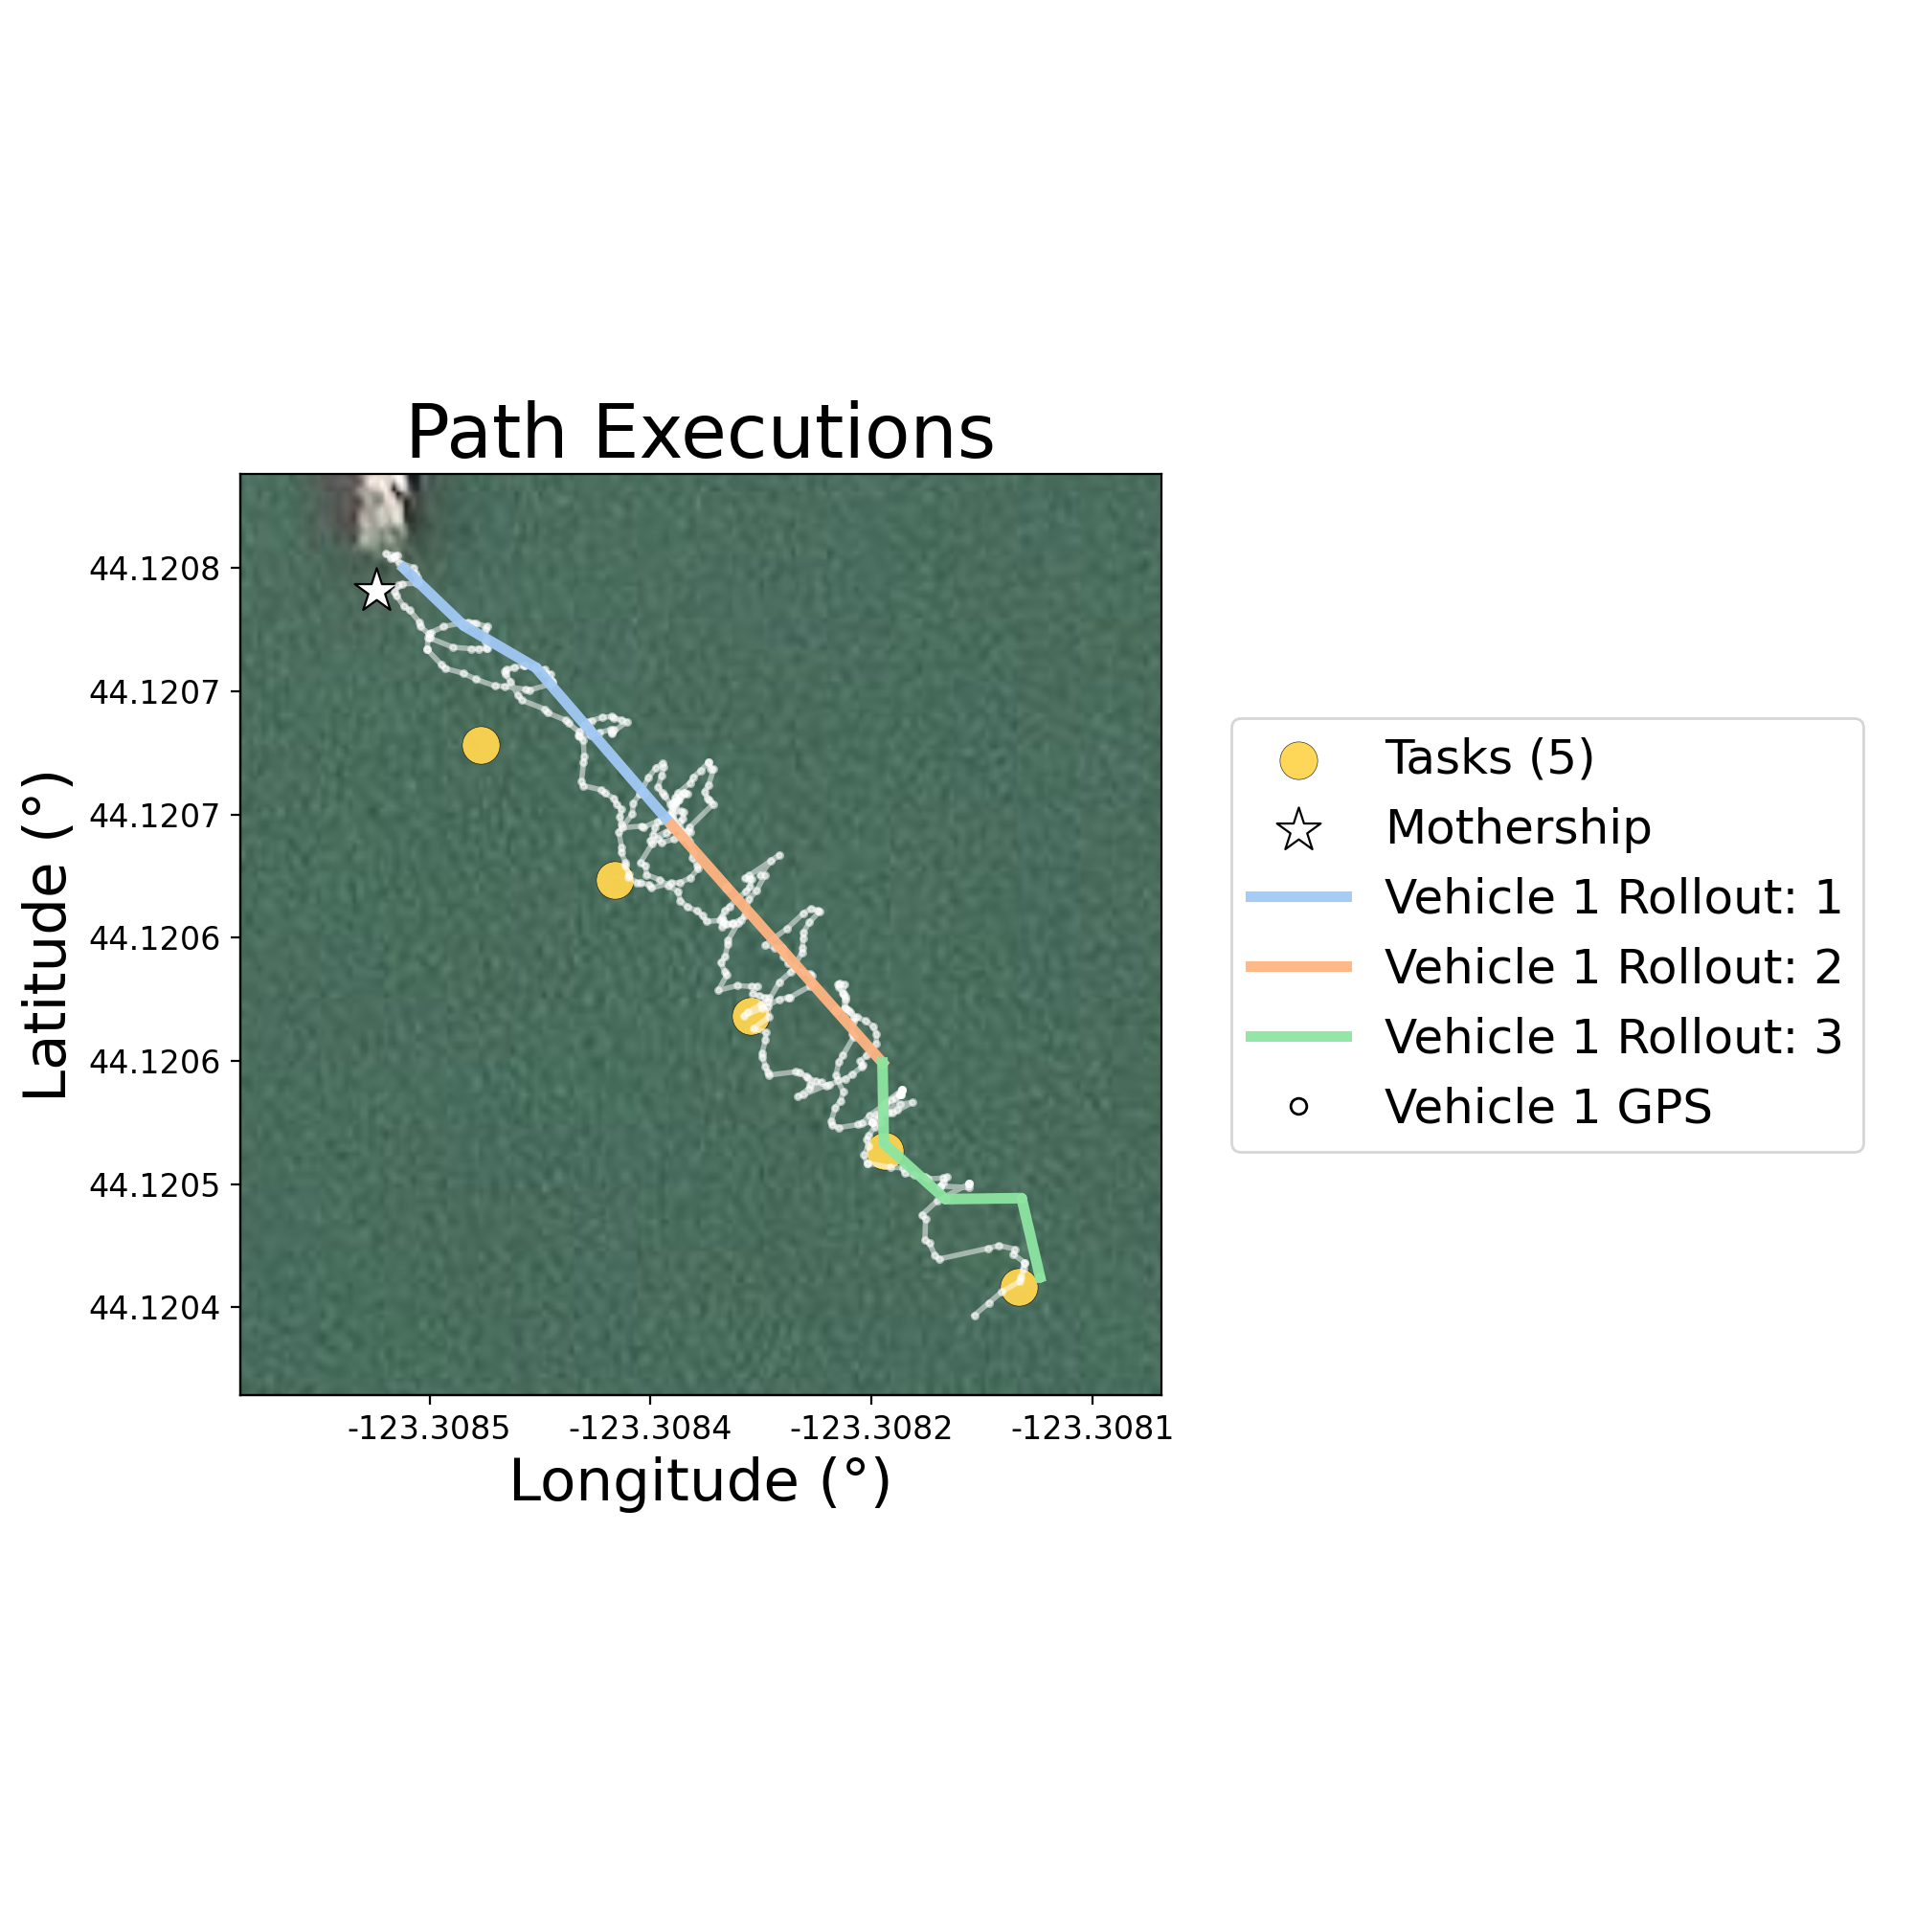
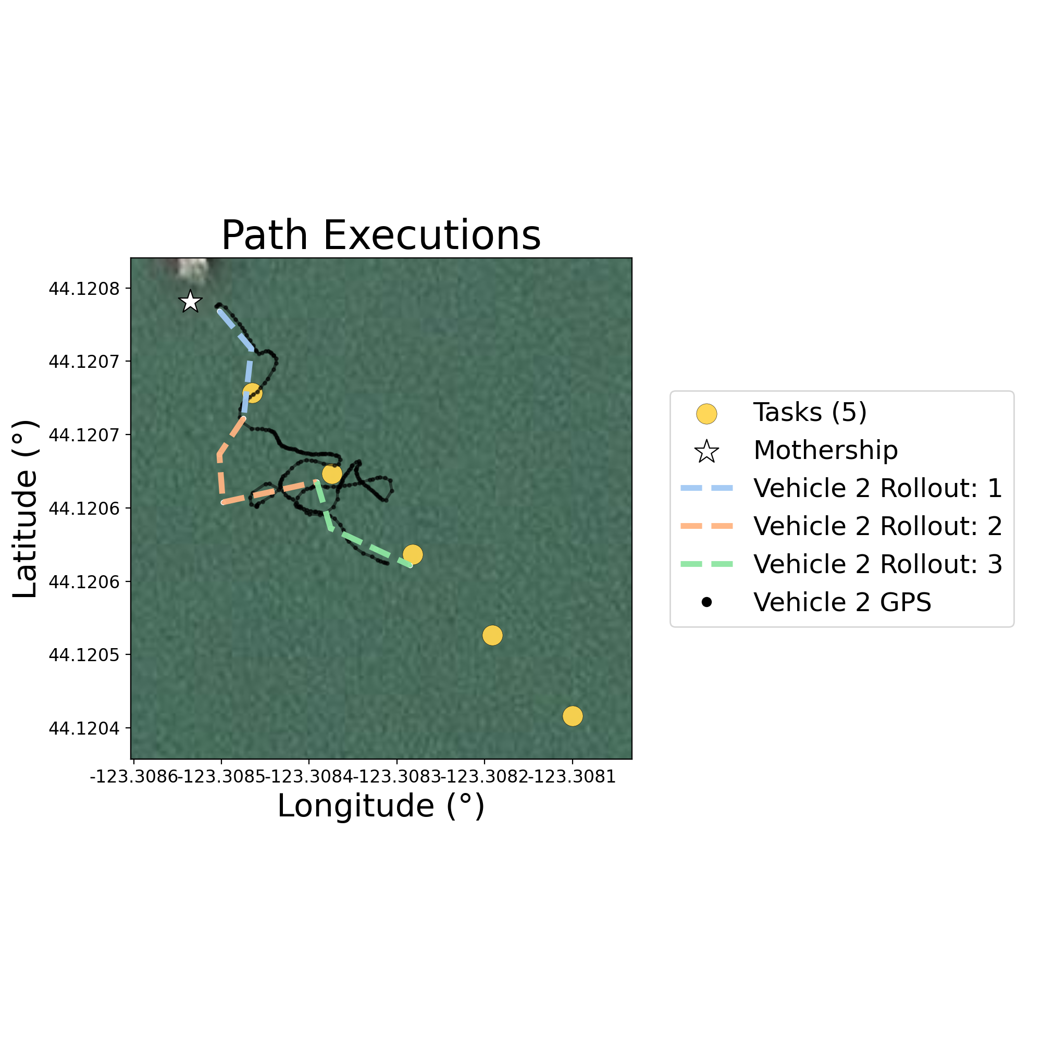
Greedy vs MCAPS Hardware Deployments
MCAPS ROV Rollouts
MCAPS USV Rollouts
Mothership
Start
Start
Tasks (5)
Step 1 Rollouts
Step 2 Rollouts
Step 3 Rollouts
Step 4 Rollouts
ROV GPS
USV GPS
Intro.
Contrib. 1
Contrib. 2
Summary

Slide 41
Contribution 2 Conclusions
Introduced Mothership-Coordinated Adaptive Passenger Specializations
Presented RL-based training framework for learning high-performing team specialization vectors
Evaluated MCAPS’s ability to coordinate robot teams in variety of environment configurations
Deployed MCAPS in real-world hardware test with USV and ROV multi-robot team at Fern Ridge Lake in Veneta, OR
Intro.
Contrib. 1
Contrib. 2
Summary

Slide 42
Contribution 2 Publications
Submission to RA-L in progress
Intro.
Contrib. 1
Contrib. 2
Summary

Slide 43
Summary
Intro.
Contrib. 1
Contrib. 2
Summary

Slide 44
Thesis Summary
Hybrid-Decentralized mission planning for Passenger team uncertain, dynamic environments
MCAPS framework supports Passenger coordination for complex tasks with infrequent Mothership updates
Algorithms support efficient, coordinated Passenger behaviors that will enable scientists to explore isolated, data-rich environments
Intro.
Contrib. 1
Contrib. 2
Summary

Slide 45
Future Work
Extending these Works
Granular plan merging for hybrid-decentralized planner
Novelty-seeking/intrinsic dense reward signals for learning MCAPS specializations
Principled multi-objective decomposition for MCAPS candidate objectives
Integrate learning Passenger policies with coordinator policy in hybrid multiagent RL framework for MCAPS
Big Picture Opportunities
Take advantage of powerful Mothership computers to perform basic science autonomously in the field, adjust team behaviors accordingly
Mothership-supported underwater localization
Intro.
Contrib. 1
Contrib. 2
Summary

Slide 46





Acknowledgements
Advisor:
Dr. Geoff Hollinger
Thesis Committee:
Dr. Kagan Tumer
Dr. Jessica Garwood
Dr. Joshua Reeves
NSF Award No.
2322055

Slide 48
Image References
TODO: Finish me
[1] Larter, Robert, Basal Melting, Roughness and Structural Integrity of Ice Shelves. Geophysical Research Letters. Volume 49, 202 10.1029/2021GL097421.
[2] M. Modasshir, S. Rahman, O. Youngquist and I. Rekleitis, Coral Identification and Counting with an Autonomous Underwater Vehicle, 2018 IEEE International Conference on Robotics and Biomimetics (ROBIO), Kuala Lumpur, Malaysia, 2018, pp. 524-529, doi: 10.1109/ROBIO.2018.8664785.
[3] S. MahmoudZadeh and A. Yazdani, Distributed task allocation and mission planning of AUVs for persistent underwater ecological monitoring and preservation, Ocean Engineering, Volume 290, 2023

Slide 49
Globally-Aligned Behaviors
Robot i Objectives
Robot j Objectives
Robot k Objectives
Comms only
Relay Comms
Mixed
Relay Comms
Relay Comms
Tasks only
Do Tasks
Do Tasks
Do Tasks
Joint objective weightings (specialization scalars) produce team behaviors that maximize performance.
Intro.
Contrib. 1
Contrib. 2
Summary

Slide 50
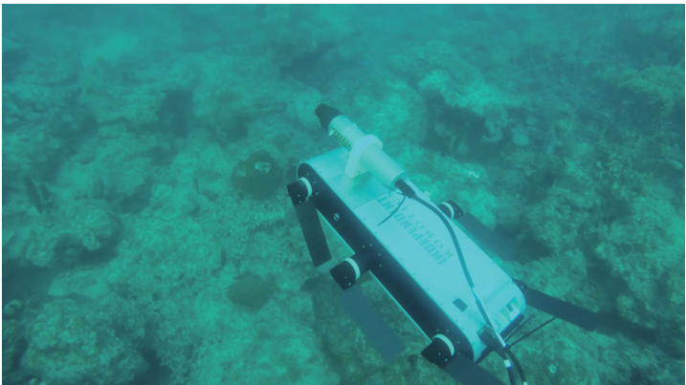
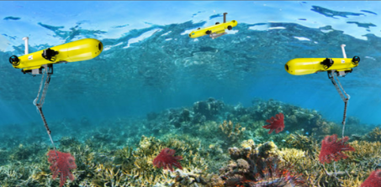
Data Collection with Autonomous Underwater Vehicles (AUVs)
Single-robot coral reef exploration
Multi-robot environmental monitoring
Modasshir et al. (2018), ROBIO
MahmoudZadeh & Yazdani (2023), Ocean Engineering
Intro.
Contrib. 1
Contrib. 2
Summary
Notes:
These factors prompt the use of AUVs for exploring this environment. AUVs have been used for marine missions before, however the hazards of the under-ice domain prompt the use of a special type of system that mitigates the risk of expensive equipment loss.

Slide 51
Emergent Behaviors with Reinforcement Learning
Allow the Mothership to learn joint specialization values that optimize team performance for different environment states
Policy
Passenger i Specialization Scalars
state, reward
Environment Rollouts
Intro.
Contrib. 1
Contrib. 2
Summary

Slide 52
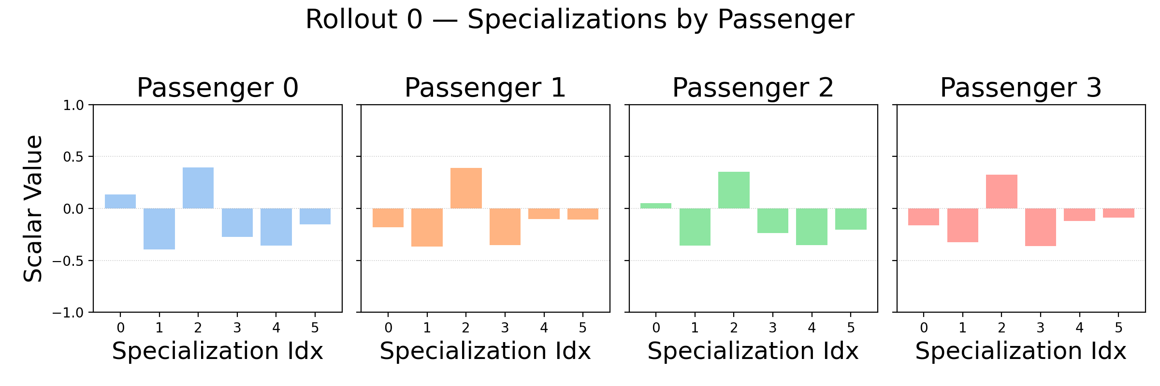
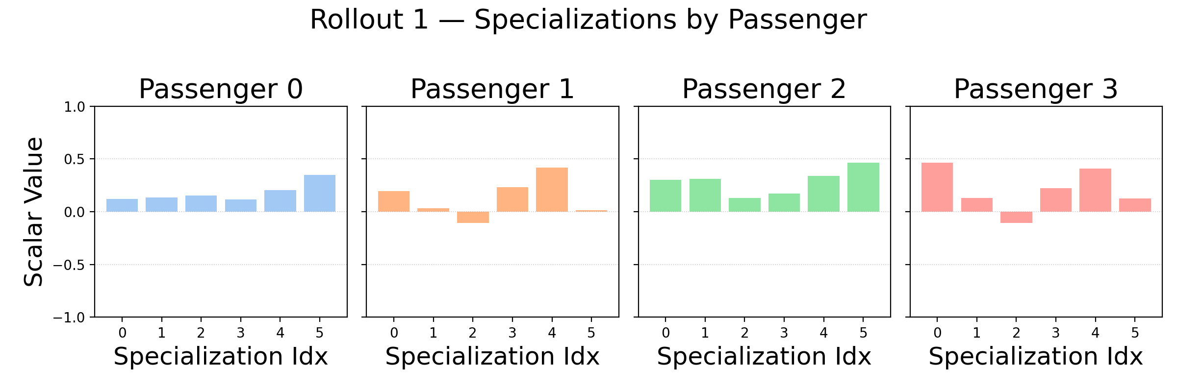
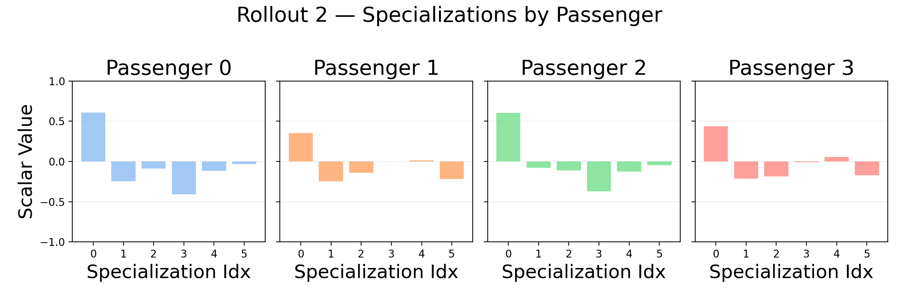
Training Evaluation – Specialization Adaptation
Step 0
Step 1
Step 2
Intro.
Contrib. 1
Contrib. 2
Summary

Slide 53
Marine Mothership-Passenger Platforms
MOOS-IvP + IvP Helm: Tends to treat Passengers only as executors, with no agency (no decentralized planning). IvP-Helm coordinates Passenger behaviors (rigid).
Behaviors: ConstantDepth/Speed, AvoidObstacles, Loiter, Surface, Waypoint etc.
These are not really planning-type behaviors that support mission-level coordination between robots
Coordinating Multiple Autonomies to Improve Mission Performance adds “Neptune,” which is sort of a Mothership-like entity

Slide 54
Marine Mothership-Passenger Platforms
Dynamic Mission Planning Framework for Collaborative Underwater Operations Using Behavior Trees: plans missions on Mothership, executes on Passengers (no replanning, limited adaptation/coordination)
Distributed task allocation and mission planning of AUVs for persistent underwater ecological monitoring and preservation
Initially centralized (not necessarily on Mothership), then decentralized

Slide 55
Gap
Most current methods favor centralized planning, decentralized execution (with minor adjustments). Not satisfactory for dynamic environments or long-range missions (must have greater decentralized autonomy).
So, how can we enhance decentralized autonomy with Mothership?
(in ways that IvP Helm cannot? I guess IvP Helm doesn’t natively plan, just adapts behaviors according to external specs…)

Slide 56
Decentralized, Role-Based Coordination
Maybe skip this slide
Intro.
Contrib. 1
Contrib. 2
Summary
Notes:
Here are some methods (Focus on adaptability required alongside intermittent communication):

